Slide 1


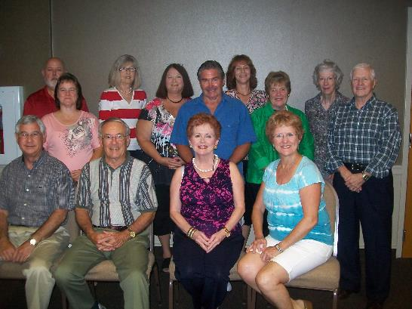

Health Coaches for Hypertension Control
Cheryl J. Dye, Professor
Joel E. Williams, Associate Professor
Janet H. Evatt, Community Coordinator
Department of Public Health Sciences, Clemson University
2009-2012. Dye, Principal Investigator. J. Williams, Co-Investigator; B. Aybar-Damali, Co-Investigator. Health Coaches for Hypertension Control. Health Resources and Services Administration (HRSA). Award: DO4RH12726-01-00. http://www.raconline.org/success/project-examples/753
2012- 2013. Dye, Principal Investigator. J. Williams Co-Investigator. Expanded Health Coaches for Hypertension Control. USDA – National Institute of Food and Agriculture. Award: 2012-46100-20122.

Slide 3
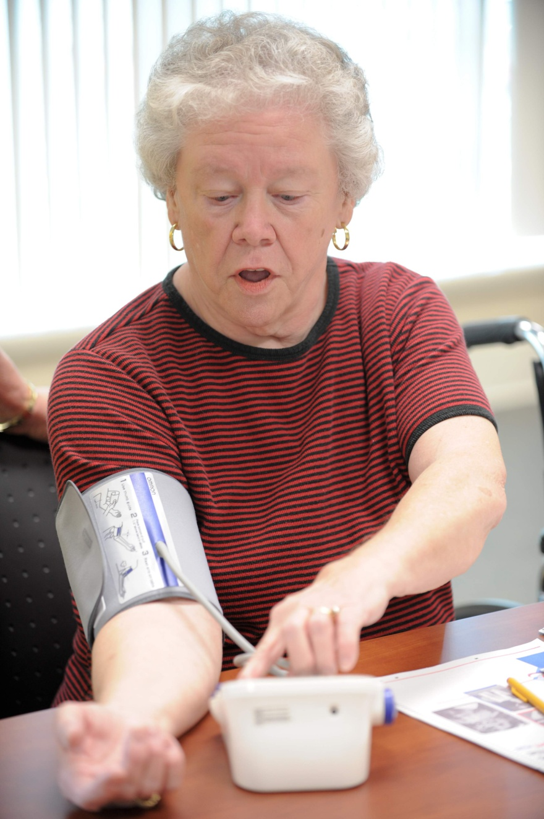
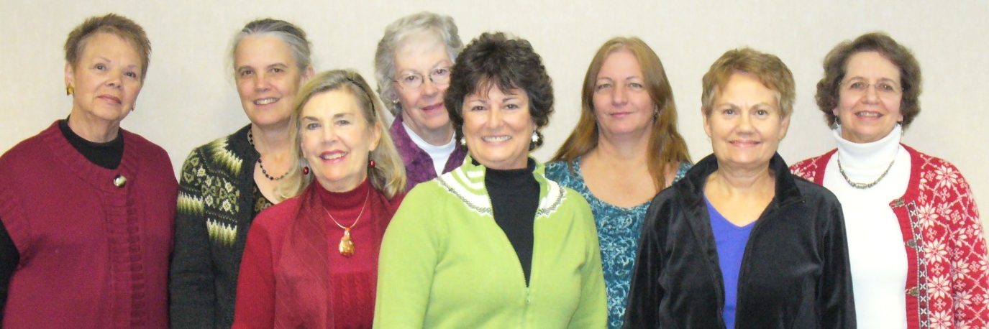
Health Coaches for Hypertension Control
The HCHC program used trained, volunteer community health workers called “Health Coaches” to teach and support older adults with hypertension in chronic disease self management.

Slide 4
Background
Compared to those living in urban areas, rural residents are:
more likely to have chronic conditions, are less educated and are poorer.
Both hypertension (HTN) and ischemic heart disease are higher in rural counties than urban areas. Lack of awareness of having HTN and lack of knowledge of how to control HTN after diagnosis places individuals at great risk.
The American Heart Association lists lack of physical activity, poor diet (especially one high in salt), overweight and obesity as major risk factors for hypertension.
The county of interest (Oconee County, South Carolina) has high rates of all hypertension risk factors. In South Carolina, hypertension prevalence is 33.2% which is higher than the national rate of 28.7%; incredibly, 2010 rates in Oconee county are even higher than the state’s at 41.7% .

Slide 5
Hypertension in Oconee Co. compared to SC
 | Oconee County | South Carolina
Prevalence (%) | 41.7 | 33.2
Age-Adjusted death rate (per 100,000)* | 58.5 | 53.3
*Mortality statistics are 2007.
Source: State of South Carolina, Department of Health and Environmental Control, Bureau of Community Health and Chronic Disease Prevention, County Chronic Disease Fact Sheet February 2010 http://www.scdhec.gov/hs/epidata/county_reports.htm

Slide 6







Project Partners
Primary Partners and Roles
Develop, coordinate, implement, and refine the program
Provide clinical measurement services and meeting space for the project
Assist in curriculum development, participant recruitment and future replication
Additional Partners

Slide 7
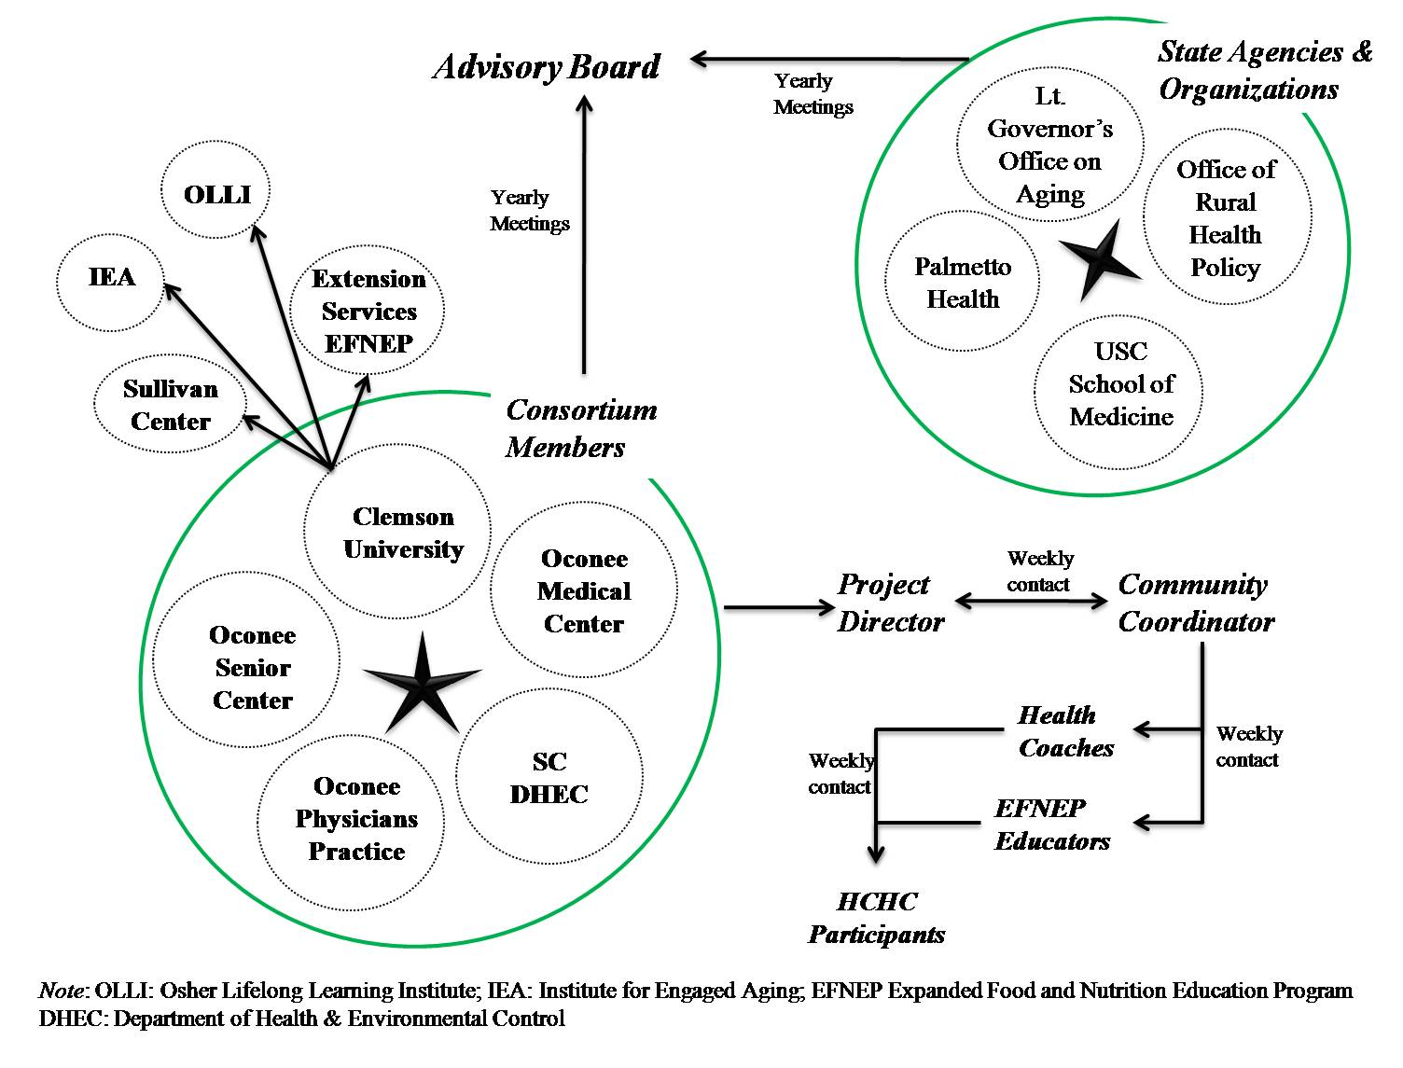

Slide 8
Data collection, literature review
Needs Assessment
  Focus groups
  Discussion with agency leaders
  Review of strategic plans at national and state level
Selection of behavior change strategies
Incorporation of best practices
  CDC , “Community Health Worker’s Heart Disease and Stroke Prevention Sourcebook”,
  NIH “Your Heart, Your Life”
  USDA-funded program, Expanded Food and Nutrition Education Program (EFNEP) provided by Extension – protocols for recruiting and training lay educators, content used in HCHC supplemental modules
Selection/development of measures – eg. HRA, self-efficacy, stage of change

Slide 9
“Best Practices”
Use of Health Risk Appraisal to increase perception of health risk of current health behaviors, to serve as basis for Individualized Action Plan, and to serve as baseline measure and outcome measure
Development of Individualized Action Plan
Peer-led educational classes
Telephone counseling
Group support
Use of Personal Health Diary
Civic Engagement benefits for Health Coaches

Slide 10
Challenges to lifestyle behavior changes in priority population
Inability to follow recommended health care regimen due to a lack of understanding and recall and a lack of support
Inability to take medications as prescribed and to recognize significant side effects
Inability to recognize “red flag” signs and symptoms that indicate a worsening of a chronic illness that requires intervention.
Characteristics of the “rural culture” of independence, self-reliance, privacy and willingness to endure hardship, including serious health problems, that influence a rural elder to wait until they are more ill before seeking health care services.
Lack of knowledge of community resources
Lack of coordination of health care and related resources
Lack of transportation, especially for those in remote areas of Mountain Rest, Long Creek and Fair Play.

Slide 11
Development of materials – training and class
Communicating with Older Adults (3 hours)
  Effective communication strategies to accommodate sensory loss
  Incorporating Principles of Adult Education in communication strategies
  Health Literacy Challenges of Older Adults and how to overcome them
Hypertension Overview– What it is, What it Can Do and How to Control It (3 hours)
  Cardiovascular Disease and Hypertension
  Hypertension and Stroke
  Weight Management
Nutrition Basics with Emphasis on Sodium Intake (3 hours)
Physical Activity Basics for those with Hypertension (3 hours)
Tobacco Use Cessation (self-implemented strategies and referral to tobacco cessation classes)
Principles of Behavior Change (3 hours)
Medication Management (1 hour)
Human Subject Protection
Community Resources and Making Referrals (2 hours)

Slide 12

HCHC Curriculum Modules by Session
Session 1: Health Risk Appraisal (HRA) and Individualized Action Plan
Session 2: Hypertension
Session 3: Nutrition
Session 4: Tobacco Use Cessation
Session 5: Physical Activity
Session 6: Medication Management
Session 7: Stress Management
Session 8: Understanding Your HRA Results and Developing an Individualized Action Plan (IAP)

Slide 13

Information and Self-Management Skills
  Health Coaches provide classes, support group facilitation, and telephone counseling to participants in order to facilitate improvement of hypertension self-management behaviors.
Hypertension Self Management
Nutrition
Physical Activity
Stress Mgmt.
Tobacco
DASH Eating Plan
Track and Reduce Sodium
Increase Steps
Deep Breathing
Progressive Muscle Relaxation
HTN
Med.
Mgmt
Protect against injury
Increase Potassium
Read Food Labels
Cessation Programs
Avoid Smoking Environments
Knowledge of the effects of hypertension on the body
Use of BP monitor
Action Plans and Health Risk
Go, Slow, Whoa
Know your numbers
Longer Term goals
Seek assistance if unable to afford
Take prescribed dosage
Short Term goals
Difference between stress and depression
Record keeping for prescription and non-prescription substances

Slide 14
Evaluation – process, impact, outcome
Recruitment, training retention, oversight of Health Coaches
Recruitment of participants
Delivery of program activities – fidelity, dose delivered, dose received – exposure and satisfaction, reach
Outcomes –
  Clinical – systolic BP, BMI, waist circumference
  knowledge, perception (self-efficacy, attitudes, etc), stage of change,
  Skill – personal action plan, goal-setting, self-monitoring
  Behavior – dietary, physical activity, stress management, tobacco use

Slide 15
Two populations – two designs
Original HCHC with 146 community members 60 years and above. Pre/Post data baseline and at 16 weeks.
Expanded HCHC (EHCHC) with 185 community members 45 years and above completed 8-week, core program. Participants batch randomized to intervention or wait-list control groups.

Slide 16
Group classes in HTN, PA, NUTR, Medication management, stress management and Individualized Action Plan (incentive: Blood Pressure Monitor and relaxation CD)
2 Group classes in Physical Activity led by a trained HC (incentive: pedometer)
HRA
(at 16 weeks)
(incentive: CDSM book)
60 years old or older with HTN, resident of Oconee County
HRA
6 Group classes in Nutrition led by EFNEP lay educator (incentive: cookbook)
No follow-up
CDSMP – Chronic Disease Self-Management Program developed by Stanford University
HC – Health Coach
HTN – Hypertension
PA – Physical Activity
NUTR – Nutrition
BP – Blood Pressure
HRA –Health Risk Appraisal
EFNEP – Expanded Food & Nutrition Education Program

Slide 17
Table 1. Participant Demographics and Cardiac Related Health Issues, N=146
*Self-report of a diagnosis with specific health issue(s)
Demographic/Health Issue | Distribution
Age
Minimum | 59
Maximum | 89
Mean (SD) | 71.55 (6.48)
Sex, n (%)
Female | 100 (68.5%)
Male | 46 (31.5%)
Race/Ethnicity, n (%)
White | 125 (85.6%)
Black/African-American | 15 (10.3%)
Hispanic | 1 (0.7%)
Other | 2 (1.4%)
Missing | 3 (2.1%)
Cardiac-Related Health Issues*, (%)
Diabetes | 20.8%
Emphysema, bronchitis, or asthma | 10.9%
Stroke | 8.7%
Congestive heart failure | 5.6%
Heart attack, angina, by-pass, or angioplasty | 5.6%
Kidney disease | 4.7%

Slide 18
Table 2. Changes in Pre-Post Readiness to Change and Self-Reported Behaviors
Readiness to Change (Indicate how ready you are to…) | Baseline | 16-week Follow-up | P-value*
not smoke or use tobacco I haven’t thought about changing I plan to change (in next 6 months) I plan to change this month I recently started doing this I do this regularly (within past 6 months) | n = 106 8 (7.5%) 2 (1.9%) 3 (2.8%) 0 (0.0%) 93 (87.7%) | n =107 4 (3.7%) 1 (0.9%) 3 (2.8%) 0 (0.0%) 99 (92.5%) | 0.289
be physically active I haven’t thought about changing I plan to change (in next 6 months) I plan to change this month I recently started doing this I do this regularly (within past 6 months) | n = 140 11 (7.9%) 13 (8 .3%) 25 (17.9%) 28 (20.0%) 63 (45.0%) | n = 136 4 (2.9%) 10 (7.4%) 8 (5.9%) 43 (31.6%) 71 (52.2%) | < .001
practice good eating habits I haven’t thought about changing I plan to change (in next 6 months) I plan to change this month I recently started doing this I do this regularly (within past 6 months) | n = 139 2 (1.4%) 13 (9.4%) 28 (20.1%) 38 (27.3%) 58 (41.7%) | n = 135 2 (1.5%) 5 (3.7%) 4 (3.0%) 49 (36.3%) 75 (55.6%) | < .001
lose weight or maintain a healthy weight I haven’t thought about changing I plan to change (in next 6 months) I plan to change this month I recently started doing this I do this regularly (within past 6 months) | n =138 4 (2.9%) 22 (15.9%) 31 (22.5%) 37 (26.8%) 44 (31.9%) | n = 131 5 (3.8%) 5 (3.8%) 13 (9.9%) 57 (43.5%) 51 (38.9%) | < .001
handle stress well I haven’t thought about changing I plan to change (in next 6 months) I plan to change this month I recently started doing this I do this regularly (within past 6 months) | n =135 8 (5.9%) 14 (10.4%) 24 (17.8%) 27 (20.0%) 62 (45.9%) | n =133 7 (5.3%) 5 (3.8%) 10 (7.5%) 35 (26.3%) 76 (57.1%) | 0.001

Slide 19
Table 3. Changes in Pre-Post Clinical Measures
 | Baseline |  | 16-week Follow-up |  | Significance
Measure | Mean | SD | Mean | SD | Difference | P-value*
Systolic BP (mm Hg) | 146.31 | 18.027 | 140.53 | 19.245 | -5.781 | 0.001
Diastolic BP (mm Hg) | 77.65 | 10.25 | 76.53 | 9.186 | -1.116 | 0.128
Weight (lbs.) | 184.24 | 42.328 | 181.77 | 41.349 | -2.475 | 0.000
Waist Circumference (in.) | 41.62 | 37.042 | 38.32 | 5.698 | -3.401 | 0.253
Total Cholesterol (mg/dl) | 185.76 | 44.261 | 183.28 | 42.738 | -2.477 | 0.309
HDL Cholesterol (mg/dl) | 53.74 | 15.286 | 53.37 | 14.724 | -0.370 | 0.523
LDL Cholesterol (mg/dl) | 105.74 | 35.845 | 104.60 | 37.063 | -1.144 | 0.467
Triglycerides (mg/dl) | 137.73 | 75.775 | 126.55 | 65.216 | -11.171 | 0.016
Glucose (mg/dl) | 110.20 | 34.739 | 105.10 | 32.430 | -5.096 | 0.004
*Student’s t-test. Bonferroni-corrected alpha level for multiple comparisons: 0.05/9=0.0055

Slide 20
Expanded HCHC project (n=185)
In EHCHC project, compared with control group participants, a higher proportion of treatment group participants moved from the cognitive to behavioral stages of motivational readiness for being physically active (P < .001), practicing healthy eating habits (P = .001), handling stress well (P = .001), and living an overall healthy lifestyle (P = .003).
They also demonstrated a greater average increase in perceived competence for self-management, F(1.134) = 4.957, P = .028, η2 = .036, and a greater increase in mean hypertension-related knowledge, F(1.160) = 16.571, P < .0005, η2 = .094.

Slide 21
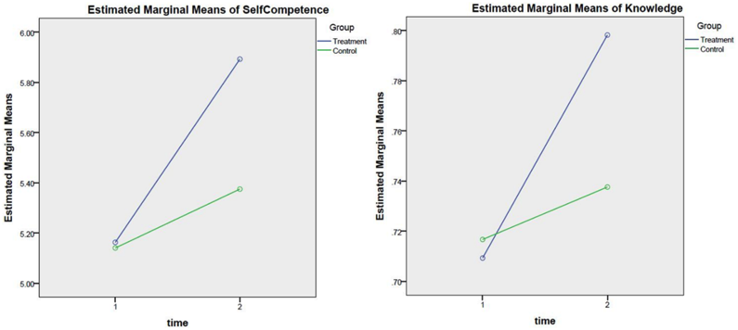

Slide 22
Conclusions
Small changes in blood pressure of 2 to 3 mmHg
25 percent to 50 percent decrease in the incidence of hypertension
annual reduction of stroke, coronary heart disease and all-cause mortality by 6 percent, 4 percent and 3 percent, respectively
(Halm & Amoako, 2008, NHANES data).
Our project has demonstrated the ability to reduce mean systolic blood pressure by 5 mmHg (p=0.001) and to reduce mean weight by 2.475 lb (p<0.001) indicating the potential to reduce stroke, coronary heart disease and all-cause mortality among program participants.
Although 40.4% of our analytic sample met the Healthy People 2020 definition of controlled hypertension at baseline, the proportion of HCHC participants meeting this definition at 16 weeks post intervention increased to 51.0%.

Slide 23
Conclusions, con’t
A US national probability sample survey, the Medical Expenditure Panel Survey, found that in 2001 the mean incremental annual per capita direct cost for a hypertensive individual was $1131 with prescription medicines, inpatient visits, and outpatient visits accounting for more than 90% of expenditures.
The cost of providing HCHC to an individual is $180 for materials and supplies. The yearly salary of $40,000 for a full-time program coordinator to recruit, train, and direct 5 volunteer community Health Coaches who can serve 200 individuals each year adds $200 to individual costs for a total of $380 per person.

Slide 24
Conclusions, con’t
HCHC also benefits the volunteer Health Coaches, most of whom are retirees. Retirees are often seeking civic engagement, volunteer opportunities, and meaningful work throughout their later years.
Enduring lifestyle changes necessary for chronic disease self-management require that psychosocial determinants of health behavior are instilled, which is typically beyond standard medical practice. We recommend peer-led, community-based programs as a complement to clinical care and support the increasing health system interest in promoting population health beyond clinical walls.

Slide 25
NIH Stage Model applied to
Health Coaches for Hypertension Control
Stage 0 – Basic Science
What are the high-risk populations for hypertension? (distribution of health outcomes in a population) Oconee County, prevalence, behavioral risk factors (BRFSS)
What are the determinants of hypertension? (lifestyle)
Why do people engage in behaviors linked with hypertension?
What strategies have proven effective in changing lifestyle?
  Applicable frameworks – Chronic Care Model, HP 2010 goals
  Applicable behavior change theories – SCT, Transtheoretical Model (SOC)
  Lay Health Advisors, Community Health Workers/ Health Coaches (peer to peer)
  Health Literacy strategies

Slide 26
Stage II, Stage III, Stage IV, Stage V
Stage II –Stage III. Efficacy -- effectiveness
implementation in Oconee County (n=330)
  close oversight of program activities,
  process, impact, and outcome evaluation
Stage IV – implementation using only Health Coach manuals and participants notebooks to maintain fidelity
Stage V - Dissemination through CU Extension

Slide 27
Publications
Dye CJ, Williams J, Evatt JH. “Activating Patients for Sustained Chronic Disease Self-Management: Thinking Beyond Clinical Outcomes”. Journal of Primary Care and Community Health. 2016. DOI:10.1177/2150131915626562.
Dye, CJ, Williams JE, Evatt JH. “Improving Hypertension Self-Management with Community Health Coaches”. Health Promotion Practice. DOI:10.1177/1524839914533797. 2014.
Dye CJ, Williams, JE, Kemper KA, McGuire F. " Impacting Mediators of Change for Physical Activity among Elderly Food Stamp Recipients”. Educational Gerontology. 38:788-798, 2012.
Dye CJ, Willoughby F, Battisto D. “Advice from Rural Elders: What it Takes to Age in Place.” Educational Gerontology. 37: 1-20, 2011.

