Slide 1
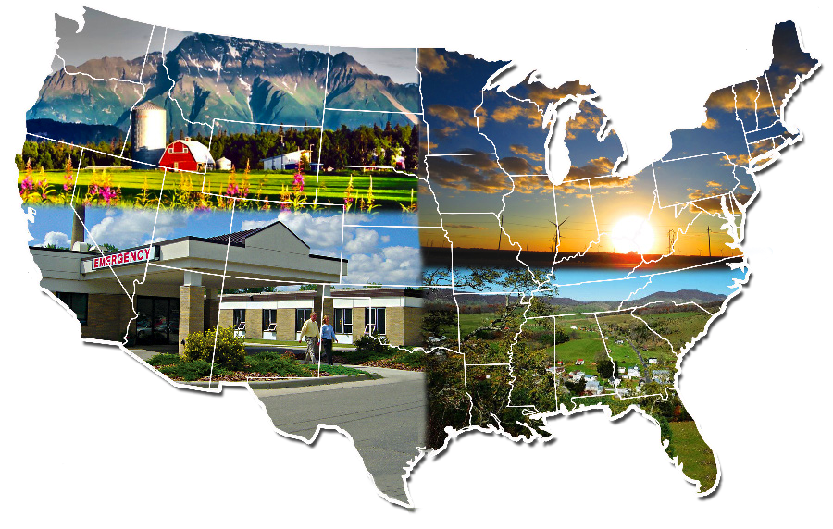
Finding Statistics and Data Related to Rural Health Selecting Rural Data in data.census.gov
April 2026
ruralhealthinfo.org

Slide 2
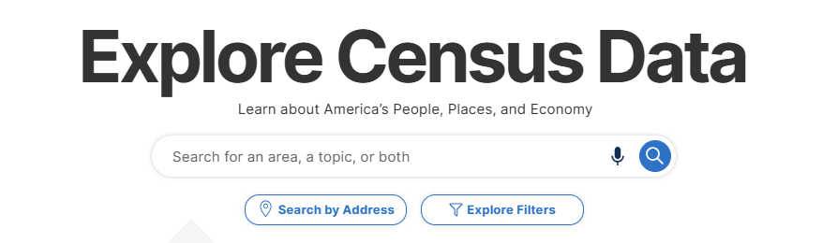
Begin at https://data.census.gov/.
Notes:
Screenshot updated

Slide 3
Method 1:
Geography, then Topic

Slide 4
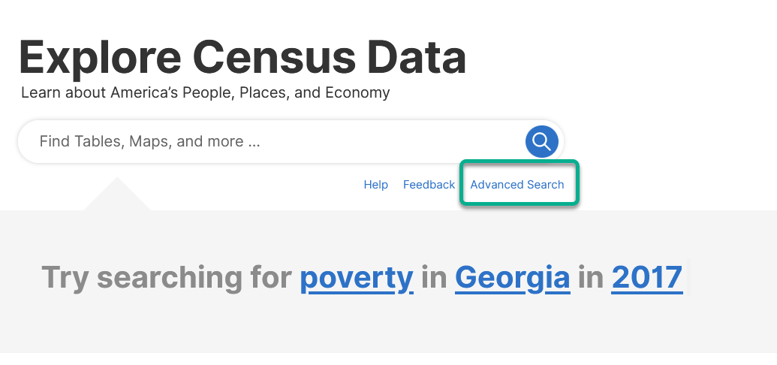
Select “Advanced Search.”
Method 1: Geography, then Topic

Slide 5
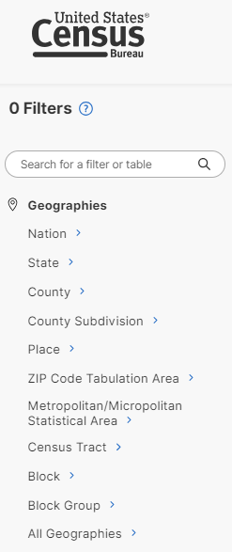
Find “Geography” in the filter panel.
Method 1: Geography, then Topic

Slide 6
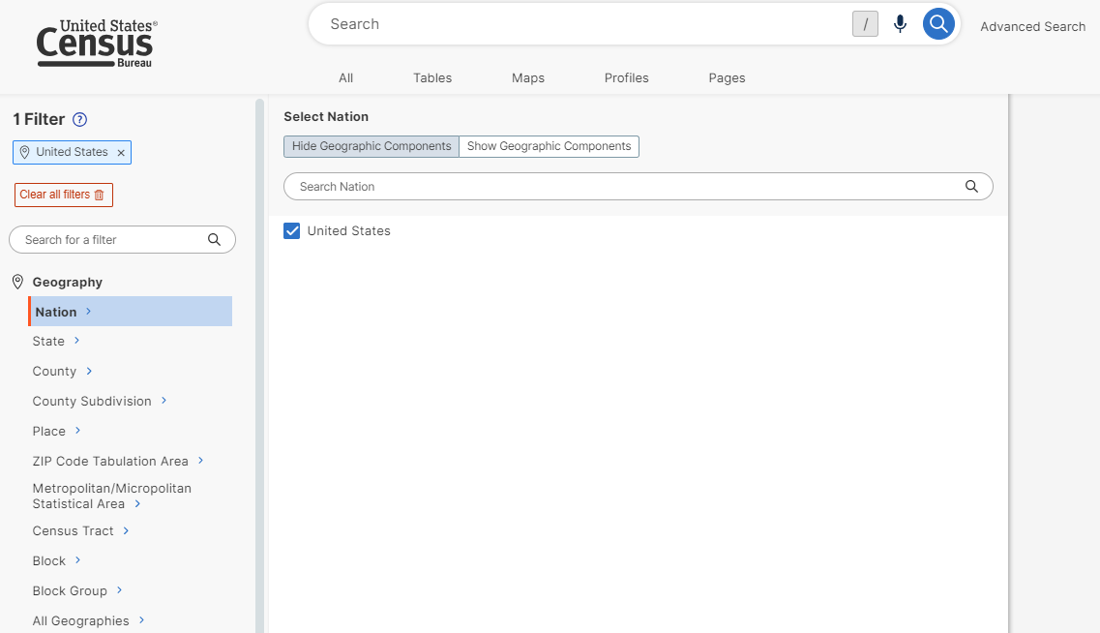
For comparison you may first want to select the United States as a whole.
Method 1: Geography, then Topic

Slide 7
Next select “Show Geographic Components.”
Method 1: Geography, then Topic

Slide 8
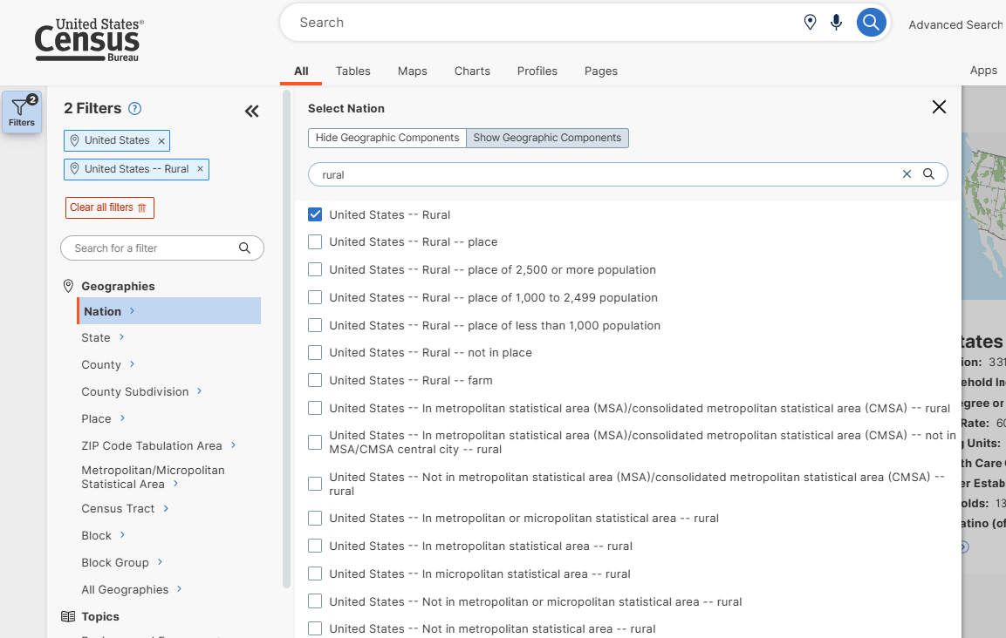
Search for “rural” to narrow the list of geographic options.
Method 1: Geography, then Topic
Notes:
Screenshot updated

Slide 9
Select the choices you want, such as “United States – Rural.”
Method 1: Geography, then Topic
Notes:
Screenshot updated

Slide 10
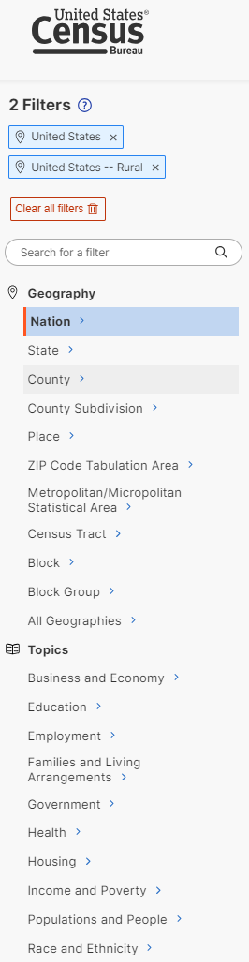
Now filter by the type of data you are interested in using the Topics filter.
Method 1: Geography, then Topic

Slide 11
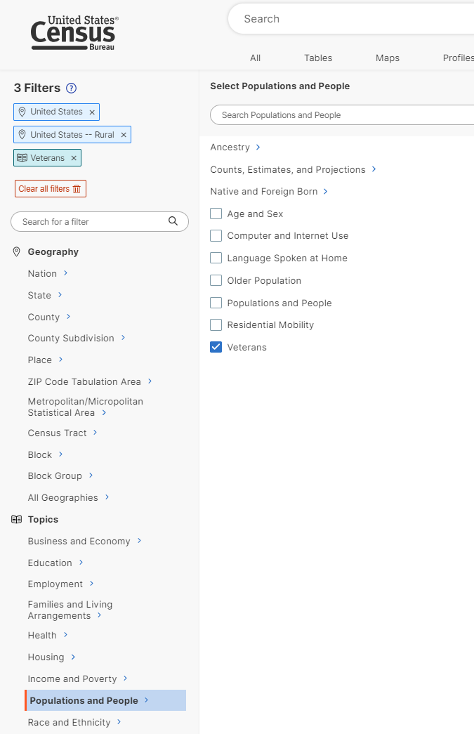
For example, you might be seeking data on veterans. Select “Populations and People” first and then “Veterans.”
Method 1: Geography, then Topic

Slide 12
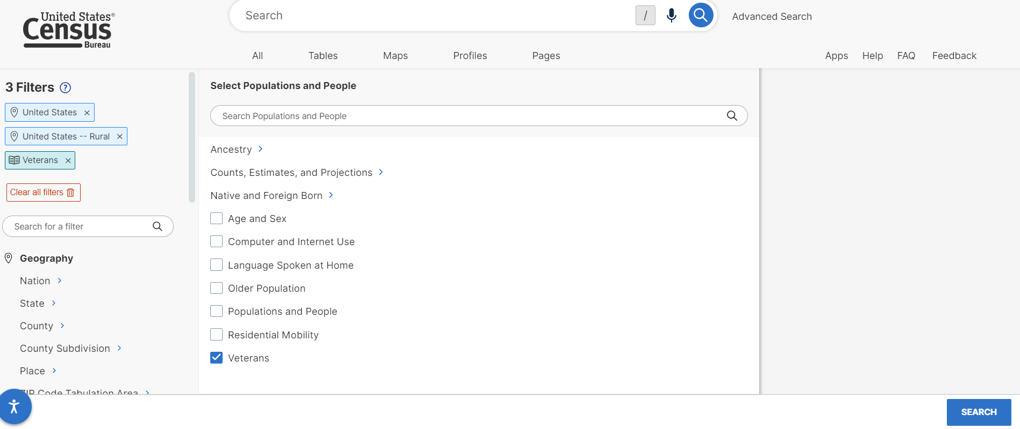
After making your selection, click the “Search” button in the bottom right.
Method 1: Geography, then Topic

Slide 13
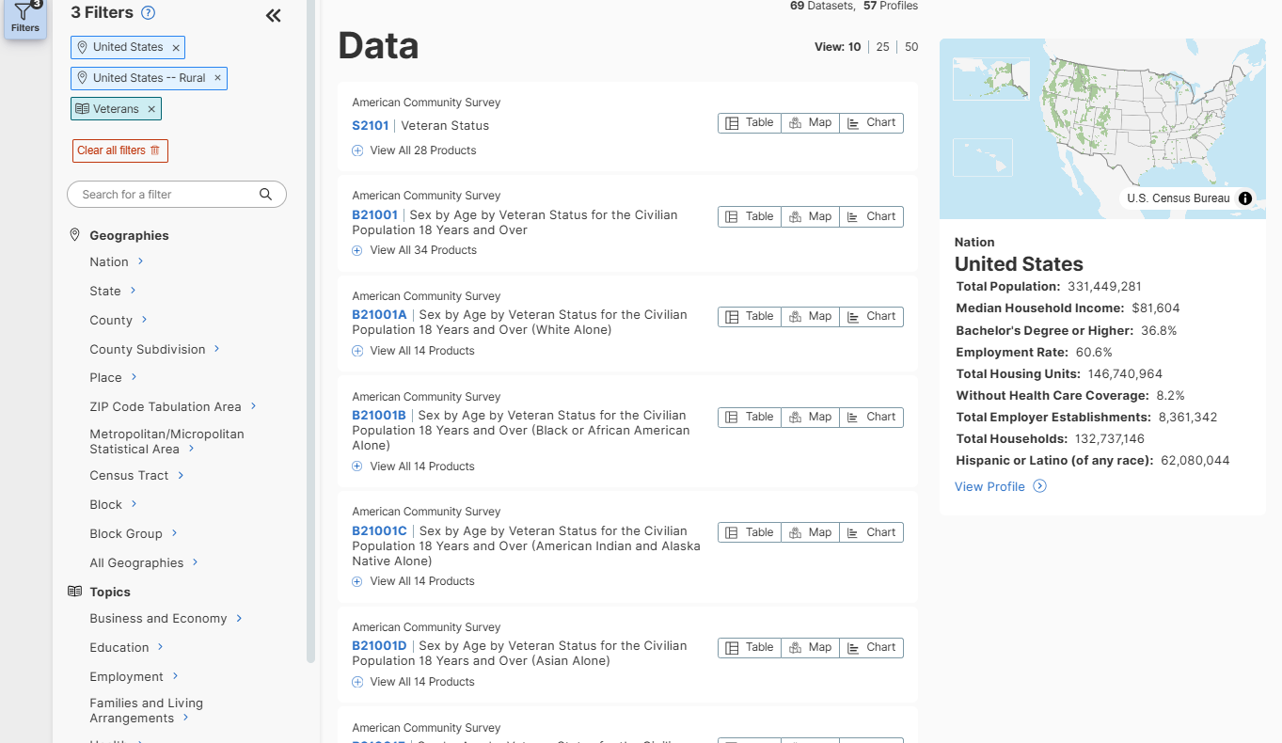
The results will list matching tables, maps, and Census web pages.
Method 1: Geography, then Topic
Notes:
Screenshot updated

Slide 14
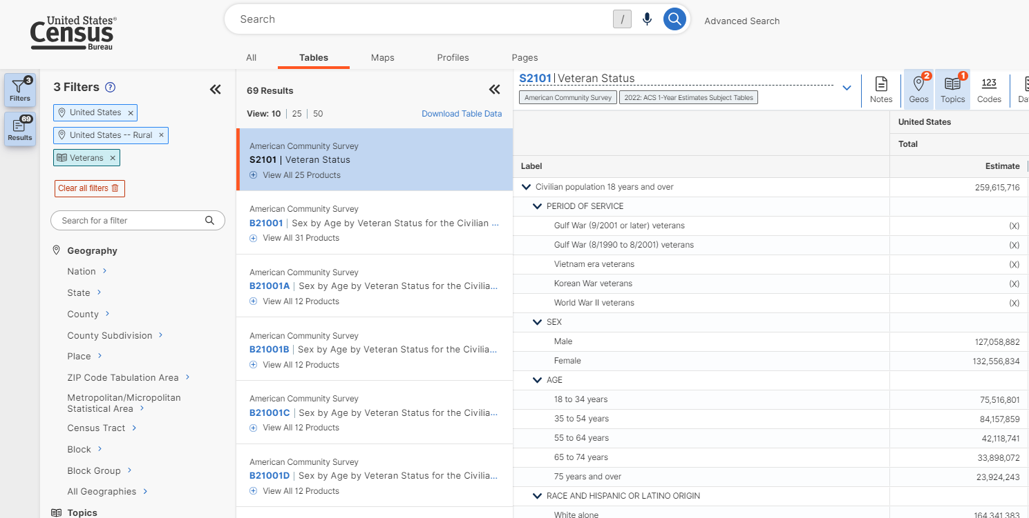
Select a table, then the arrows to collapse the filter and result menus.
Method 1: Geography, then Topic

Slide 15
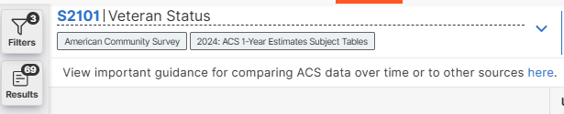
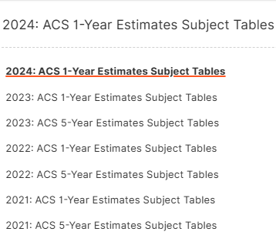
Switch the table to the ACS 5-Year Estimates.
Method 1: Geography, then Topic
Notes:
Screenshots updated

Slide 16
Method 2:
Topic, then Geography

Slide 17
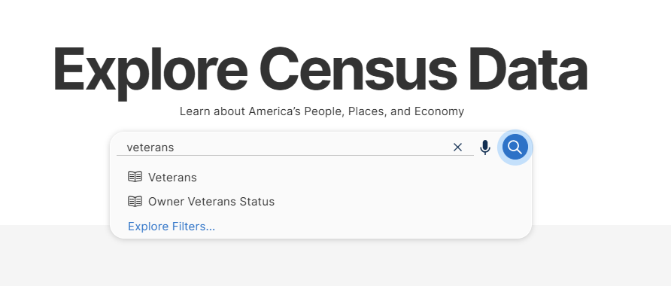
From the main page enter your topic and click “Search.”
Method 2: Topic, then Geography
Notes:
UPDATE

Slide 18
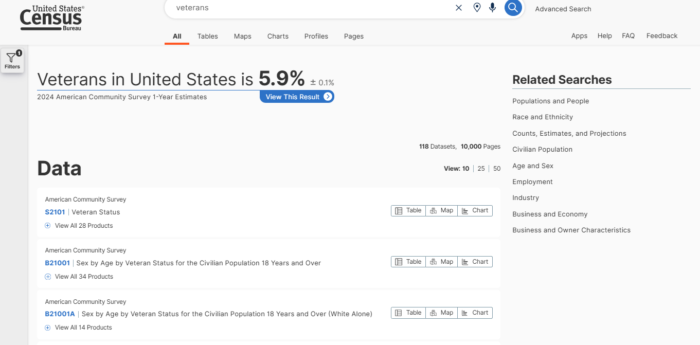
The results will list matching tables, maps, and Census web pages. 2
Method 2: Topic, then Geography
Notes:
Slide updated

Slide 19
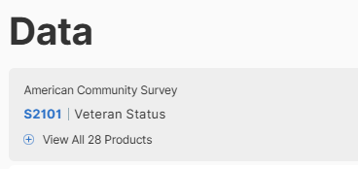
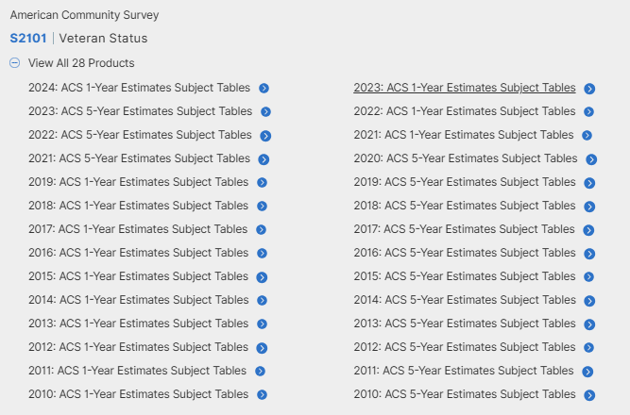
Select the “+” under the table and select ACS 5-year Estimates.
Method 2: Topic, then Geography
Notes:
Screenshot updated

Slide 20
Select “Geos” to pick the geographies of interest to you.
Method 2: Topic, then Geography

Slide 21
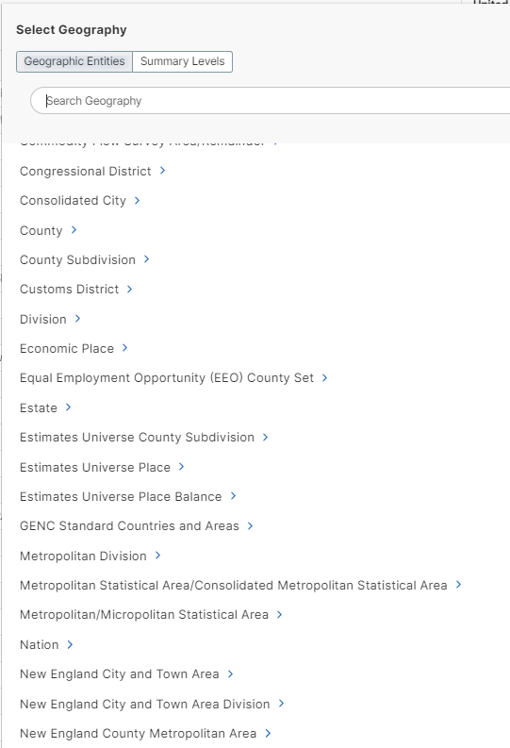
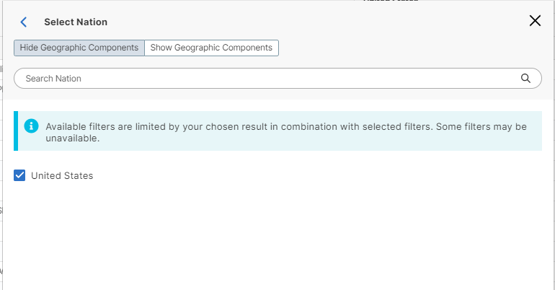
Select “Nation” then “United States.”
Method 2: Topic, then Geography

Slide 22
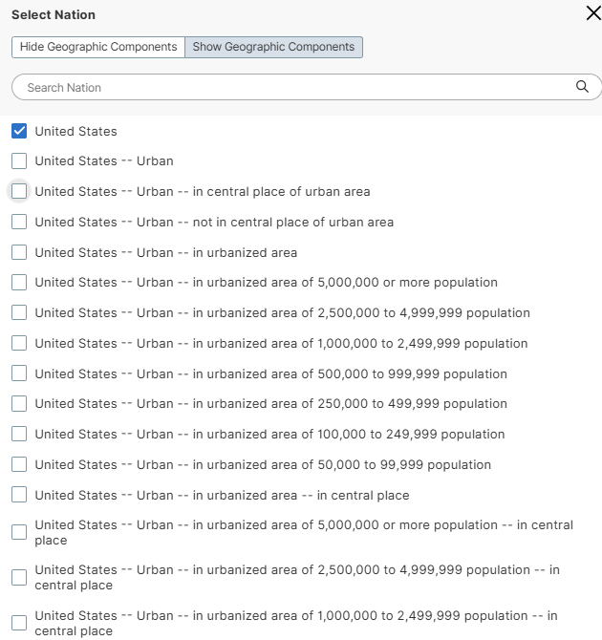
Click the “Show Geographic Components” option.
Method 2: Topic, then Geography
Notes:
Screenshot updated

Slide 23
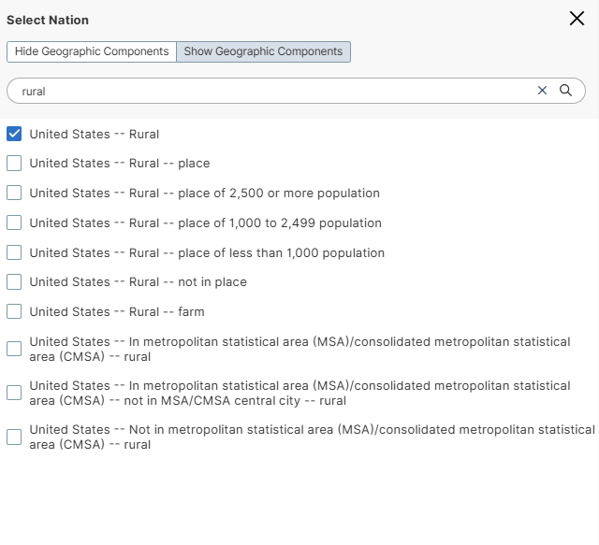
Select “United States – Rural.”
Method 2: Topic, then Geography
Notes:
Screenshot updated

Slide 24
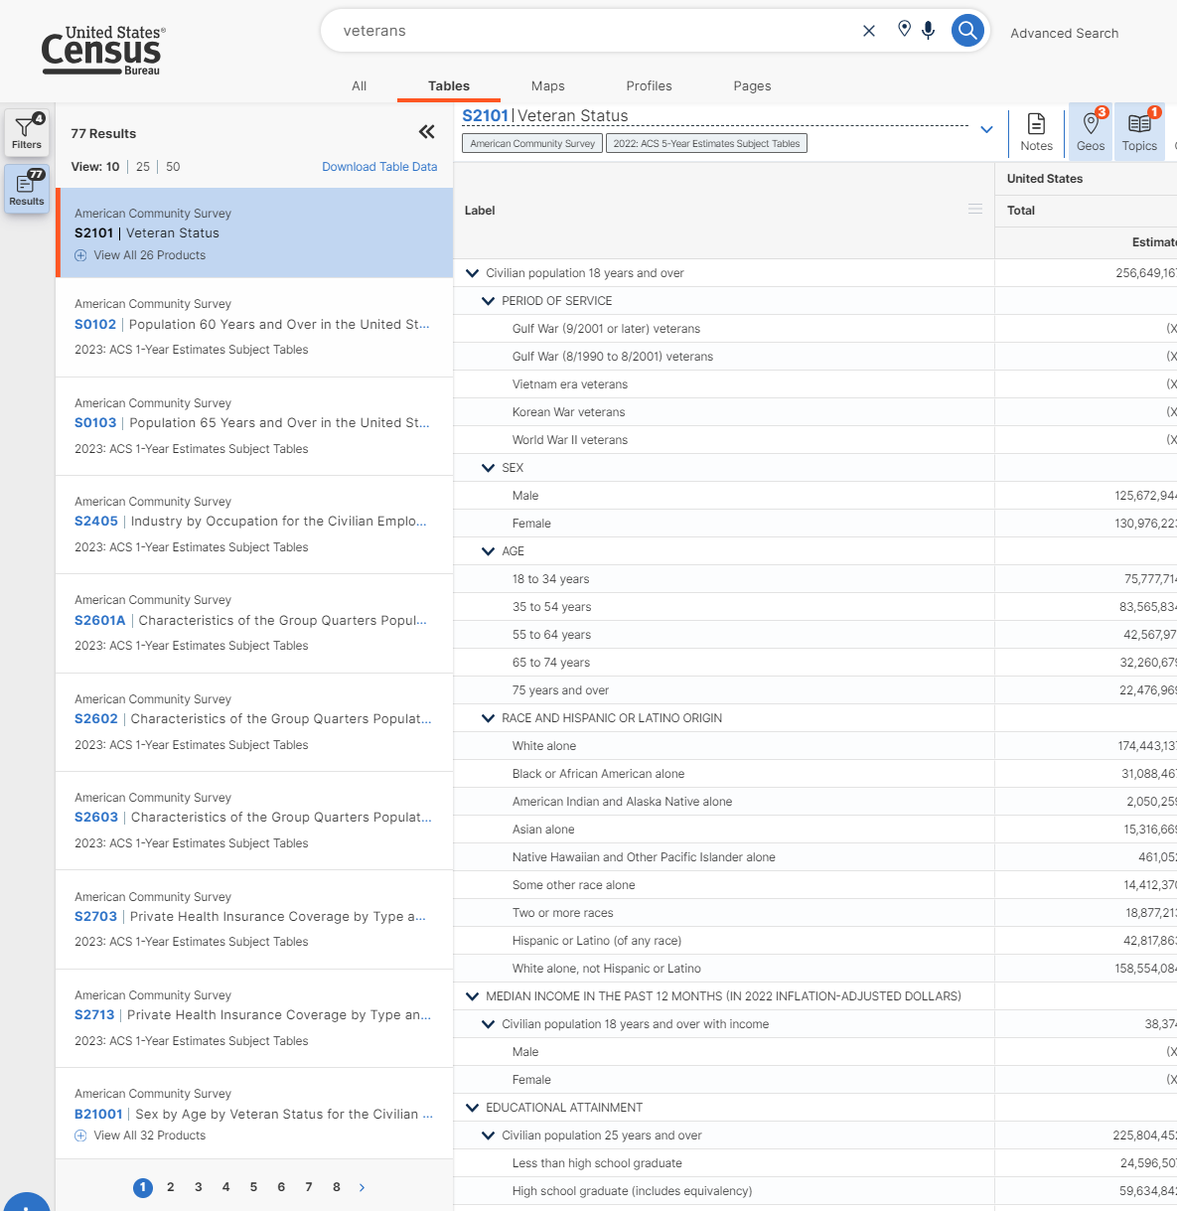
Use the arrows to collapse the result menu.
Method 2: Topic, then Geography

Slide 25
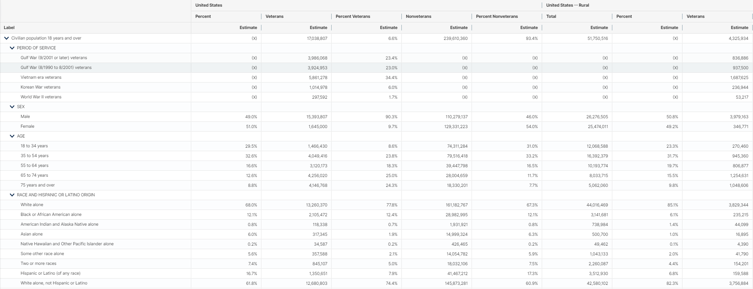
You will get detailed data for the geography and topic selected.
United States
United States -- Rural
Method 2: Topic, then Geography

Slide 26
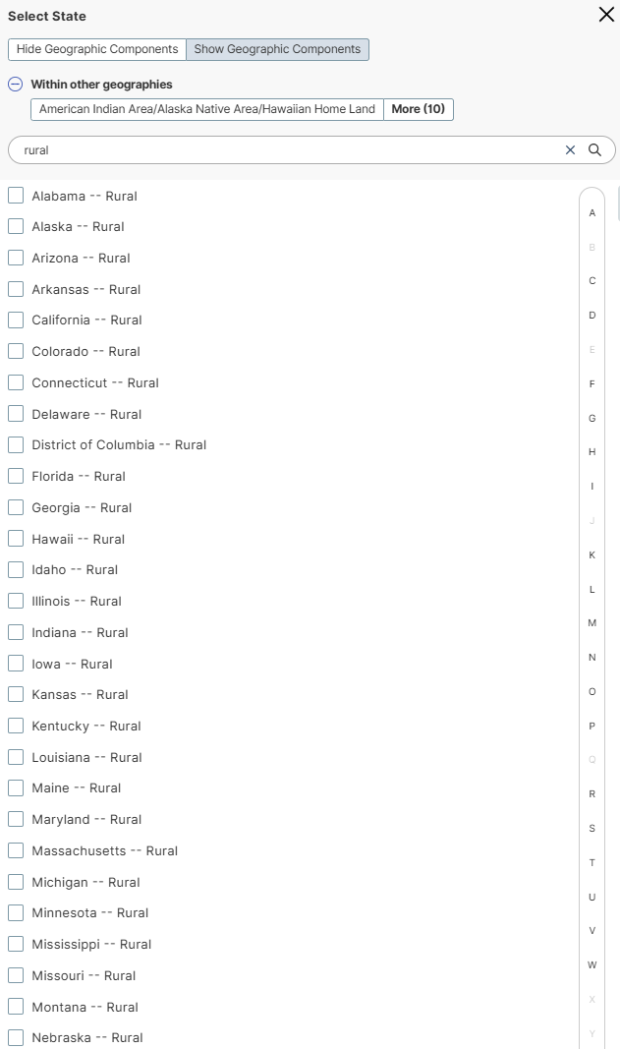
Similarly, you could switch to State, Show Geographic Components, search for “rural” and add geographies.
Method 2: Topic, then Geography
Notes:
Screenshot and text updated

Slide 27
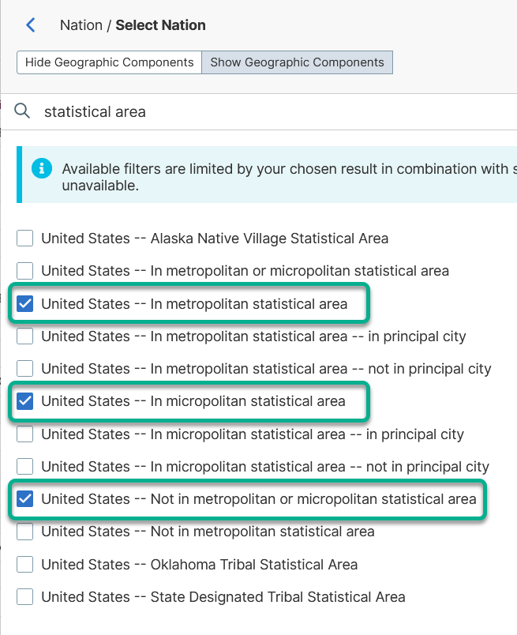
To compare metropolitan, micropolitan (large rural), not metro/micro (small rural), select these:
Method 2: Topic, then Geography

Slide 28
Navigating the Display and Customizations

Slide 29
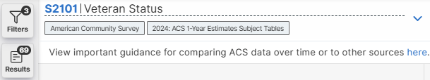
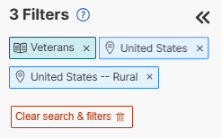
The choices you’ve added can be viewed in the filters panel.
Navigation and Customizations
Notes:
Screenshot updated

Slide 30
Customization Options
You can adjust how your data is displayed using the menu ribbon at the top of the table. For example, if you want to display only the data columns and not the margin of error, you can toggle that off by clicking it:
Navigation and Customizations
Notes:
Screenshot updated

Slide 31
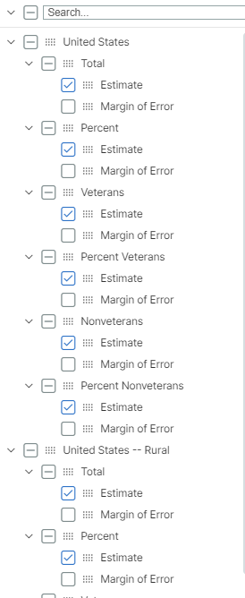
For large tables, use “Columns” to view only the data you need
Navigation and Customizations
Notes:
Screenshot updated

